Slide 1
SG ALLIED BUSINESSES LIMITED
B-40, S.I.T.E, KARACHI, PAKISTAN

Slide 2
1. REASON OF NON-COMPLIANCES
The company’s operations were shut down in December 2006 unfortunately due to higher cost of production.
No support from the Government by putting anti-dumping on imported polyester filament yarn.
Very poor law and order situation in SITE Karachi.

Slide 3
Non reliable Gas supply, therefore stable power which is essential for making of polyester filament yarn was not available.
As operations were shut down there was no cash flow and losses, and all the staff had to be released which resulted in these non-compliances.

Slide 4
2. STEPS TAKEN BY THE COMPANY FOR RECTIFICATION OF NON-COMPLIANCES AND TO ENSURE THAT SUCH NON-COMPLIANCES DO NOT OCCUR IN FUTURE
The main issue was to make company profitable so that staff can be hired to make sure there are no non-compliances.
Alhamdulillah Company is now in profit and further expanding its operations and inshaa Allah with the result we see that all non-compliances will be met.

Slide 5
3. REASONS FOR NON-OPERATION OF THE COMPANY AND THE STEPS TAKEN BY THE COMPANY FOR ITS REVIVAL
As explained earlier there was no profit, in fact there were huge losses in making polyester filament yarn therefore the operation were shut down and even after waiting till 2014 the management was hopeful that soon the situation might change and they can restart the company but unfortunately this didn’t happen.
So company started new lines of businesses which are as follows:
  Warehousing.
  Cold storage.
  Vertical Farming.
  Mushroom Production.

Slide 6
With these new lines of businesses revival plan was submitted to SECP which was approved.

Slide 7
4. REASONS FOR NON-DECLARATION OF ANY CORPORATE ENTITLEMENT TO ITS SHAREHOLDERS SINCE PAST MANY YEARS
There was no profit in the company therefore there was non-declaration of any corporate entitlement.

Slide 8
5. STRATEGY FOR RESTORATION OF OPERATIONS OF THE COMPANY AND TO SAFEGUARD THE INTEREST OF MINORITY SHAREHOLDERS
Strategy is there and Alhamdulillah we will expand our new lines of businesses Cold storage, Vertical Farming and Mushroom Production.
Already 3 Cold stores are in operation and order for 4th one is already placed.
Vertical farm was expanded last year and after evaluating profitability we will inshaa allah expand further.

Slide 9
Company is investing in Mushroom Farm Production which will be inshaa allah our Monopoly.
Our Vertical farm also has unique position in the market as we supply round the year high value herbs and vegetables which are not available from any other company.

Slide 10
PROJECTED PROFIT AND LOSS AFTER MUSHROOM PRODUCTION
Profit & Loss Projection | 30th June 2020 | 30th June 2021 | 30th June 2022 | 30th June 2023 | 30th June 2024
Revenue
Rental Income | 37,938,838 | 64,864,794 | 71,351,273 | 78,486,401 | 86,335,041
Cold Storage Income | 3,516,148 | 3,969,624 | 4,366,586 | 4,803,245 | 5,283,570
Vertical Farm | 1,729,302 | 9,101,456 | 10,011,602 | 11,012,762 | 12,114,038
Mushroom | - | 1,500,000 | 60,000,000 | 120,000,000 | 132,000,000
Total Excluding Tax | 43,184,288 | 79,435,874 | 145,729,461 | 214,302,408 | 235,732,648
Expenses
Cost of Goods Sold | 2,650,415 | 3,959,852 | 4,355,837.20 | 4,791,421 | 5,270,563.01
Depreciation | 8,469,280 | 8,062,202 | 7,659,091.90 | 7,276,137.31 | 6,912,330.44
Director's Remuneration | 2,400,000 | 3,840,000 | 3,840,000 | 3,840,000 | 3,840,000
Electricity Charges | 5,658,930 | 14,820,006 | 16,302,006.60 | 17,932,207 | 19,725,428
Entertainment | - | 100,000 | 110,000.00 | 121,000 | 133,100
Generator Fuel | 18,000 | 178,880 | 196,768.00 | 216,445 | 238,089
Maintenance - generator | 182,450 | 964,876 | 1,061,363.60 | 1,167,500 | 1,284,250
Maintenance | - | 100,000 | 110,000.00 | 121,000 | 133,100
Building repair and Maintenance | 922,042 | 1,280,000 | 1,408,000.00 | 1,548,800 | 1,703,680
Miscellaneous | 392,911 | 5,506,640 | 6,057,304.00 | 6,663,034 | 7,329,338
VF and Mushroom Packing Material | 168,635 | 350,000 | 1,008,000 | 1,108,800 | 1,219,680

Slide 11
Petty Cash Expenses | 83,705 | 2,181,880 | 2,290,974 | 2,520,071 | 2,772,079
Professional Fee - Corporate | 743,000 | 412,000 | 432,600 | 475,860 | 523,446
Professional Fee | 978,500 | 5,353,124 | 2,000,000 | 2,200,000 | 2,400,000
Property Tax | 580,000 | 1,374,346 | 1,443,063 | 1,587,370 | 1,746,107
Repair and Maintenance | 1,672,143 | 547,250 | 574,613 | 632,074 | 695,281
Repair and Maintenance - VF | - | 414,000 | 434,700 | 478,170 | 525,987
Salaries. | 14,662,652 | 19,351,040 | 20,318,592 | 22,350,451 | 24,585,496
Staff Welfare | 20,963 | 72,000 | 75,600 | 83,160 | 91,476
Professional Tax | 200,000 | 300,000 | 315,000 | 346,500 | 381,150
Telephone | 125,720 | 232,700 | 244,335 | 268,769 | 295,645
Travel Expense | 368,772 | 60,684 | 63,718 | 70,090 | 77,099
Wages | - | 2,235,280 | 2,347,044 | 2,581,748 | 2,839,923
Water Charges - Drinking | 102,060 | 54,400 | 57,120 | 62,832 | 69,115
Water Tanker | - | 948,080 | 995,484 | 1,095,032 | 1,204,536
Mushroom Raw Material | - | 600,000 | 15,000,000 | 30,000,000 | 33,000,000
Mushroom Salaries | - | 1,200,000 | 3,600,000 | 6,500,000 | 7,150,000
 | 40,400,178 | 74,499,240 | 92,301,214 | 116,038,472 | 126,146,899
Financial charges | - | 8,930,402 | 9,376,922 | 9,845,768 | 10,338,057
Taxation | - | 1,731,473 | 1,748,788 | 1,766,276 | 1,854,590
Profit/(Loss) | 2,784,110 | - 5,725,241 | 42,302,537 | 86,651,891 | 97,393,103

Slide 12
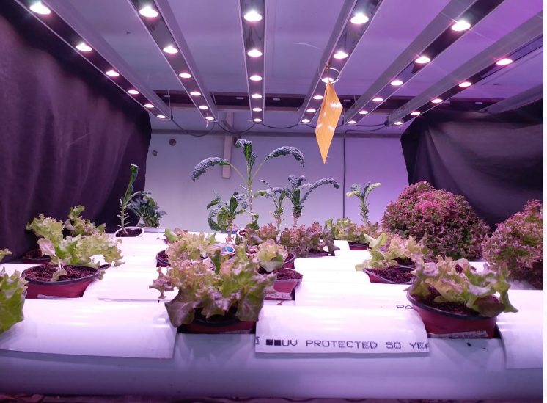
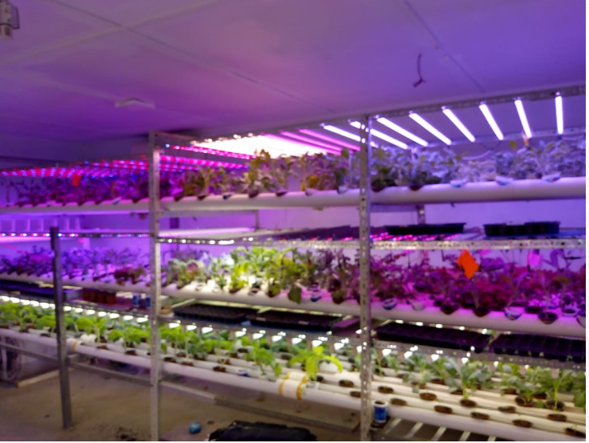
VERTICAL FARM

Slide 13
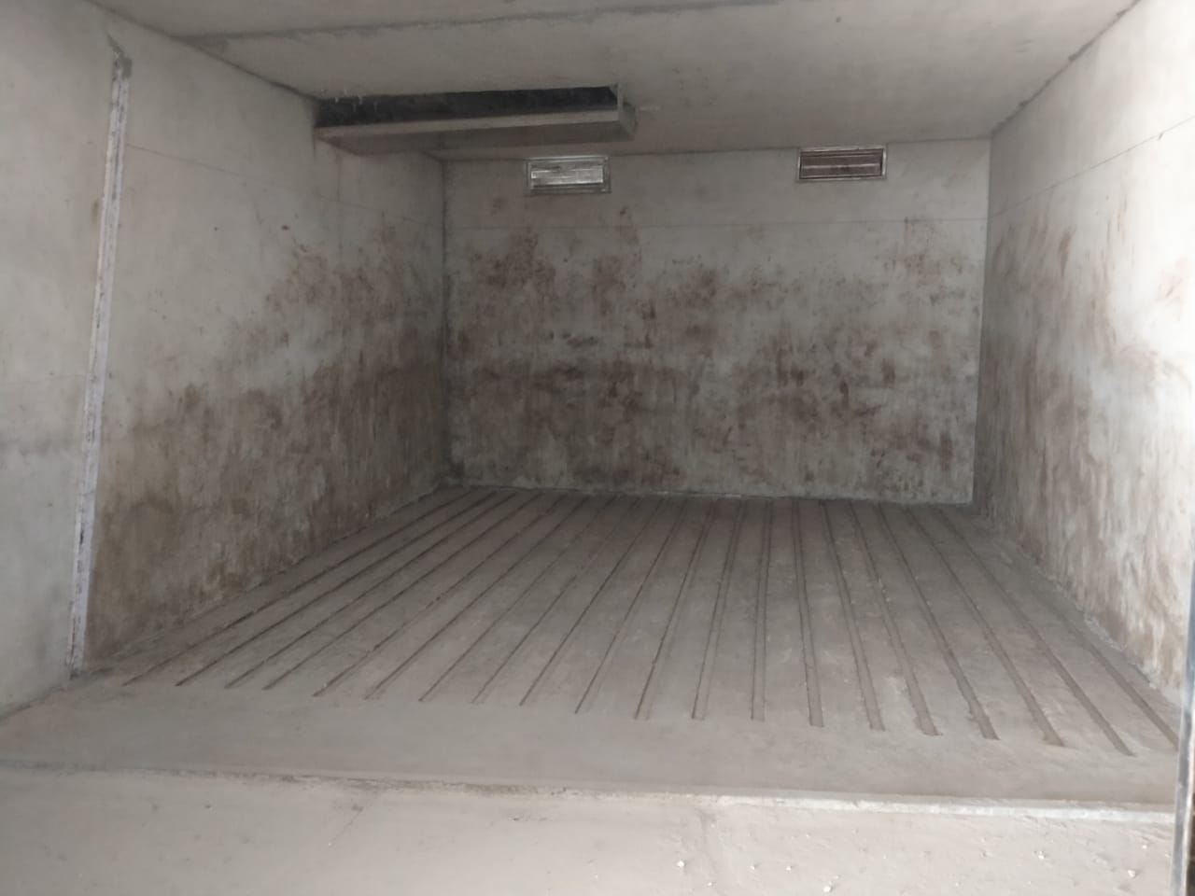
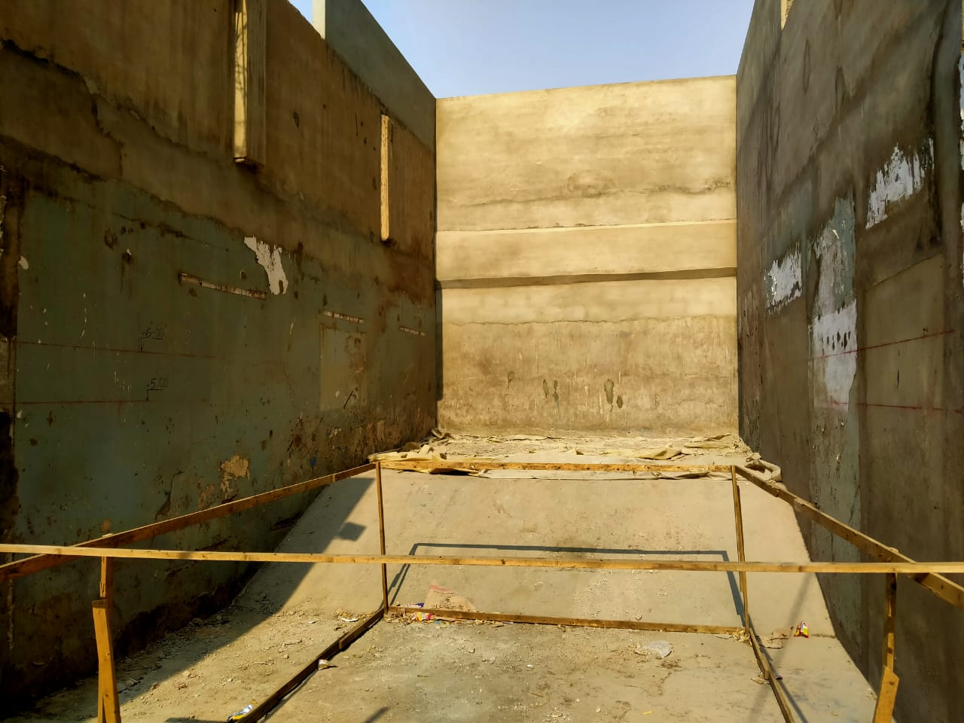
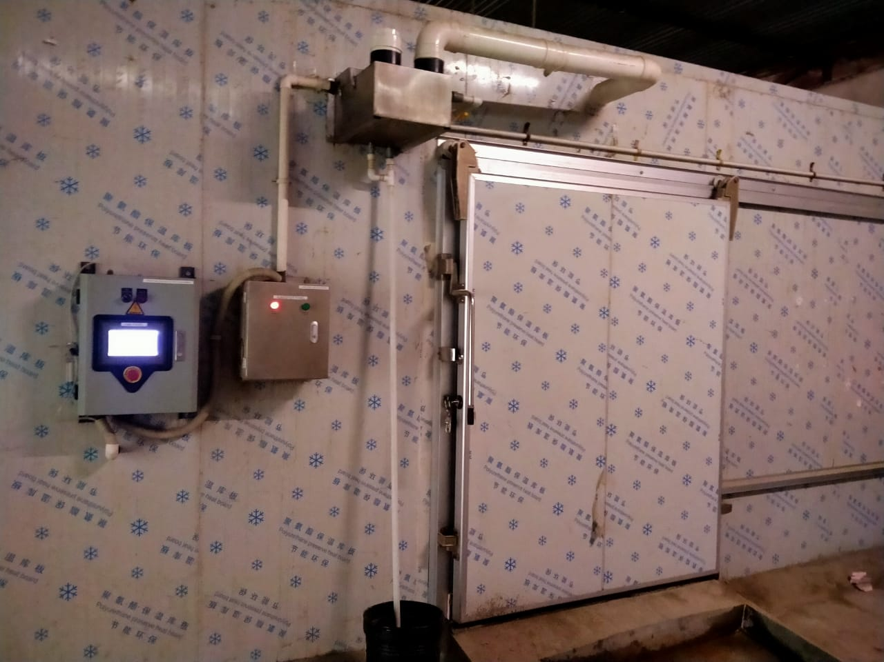
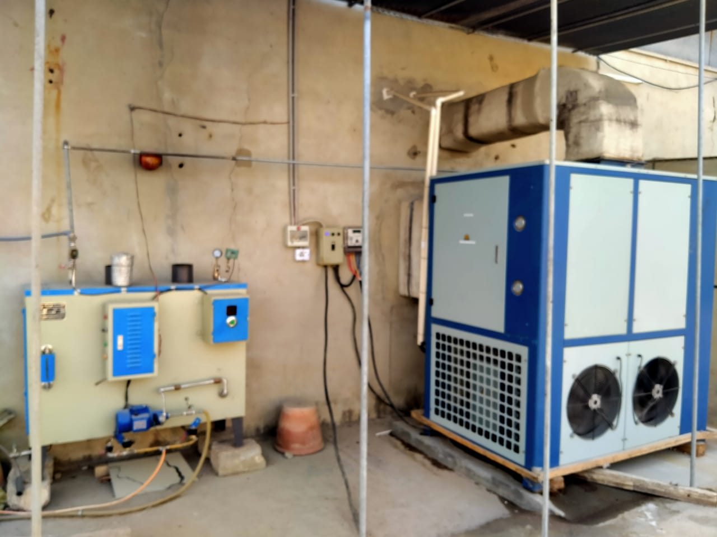
MUSHROOM PRODUCTION

Slide 14
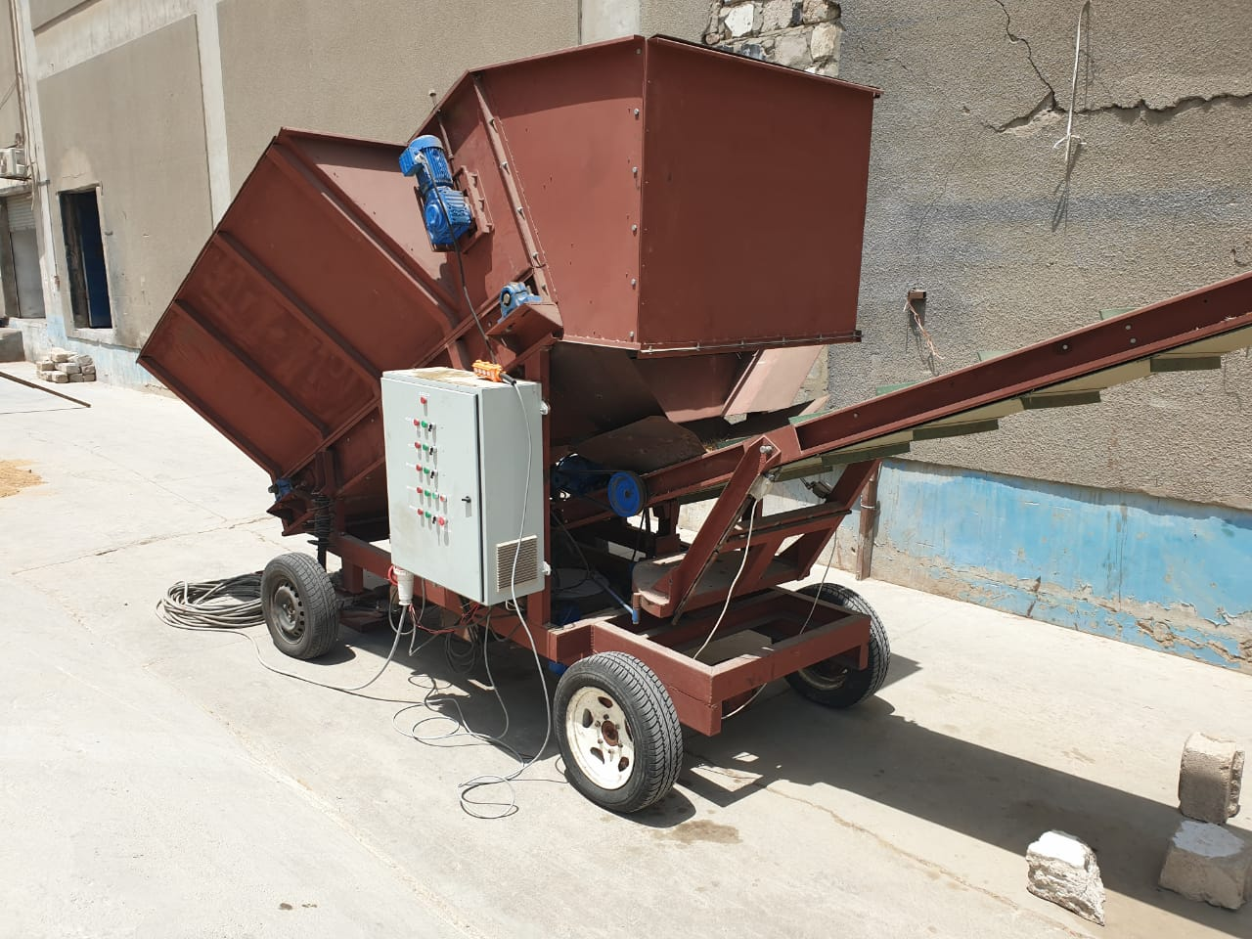
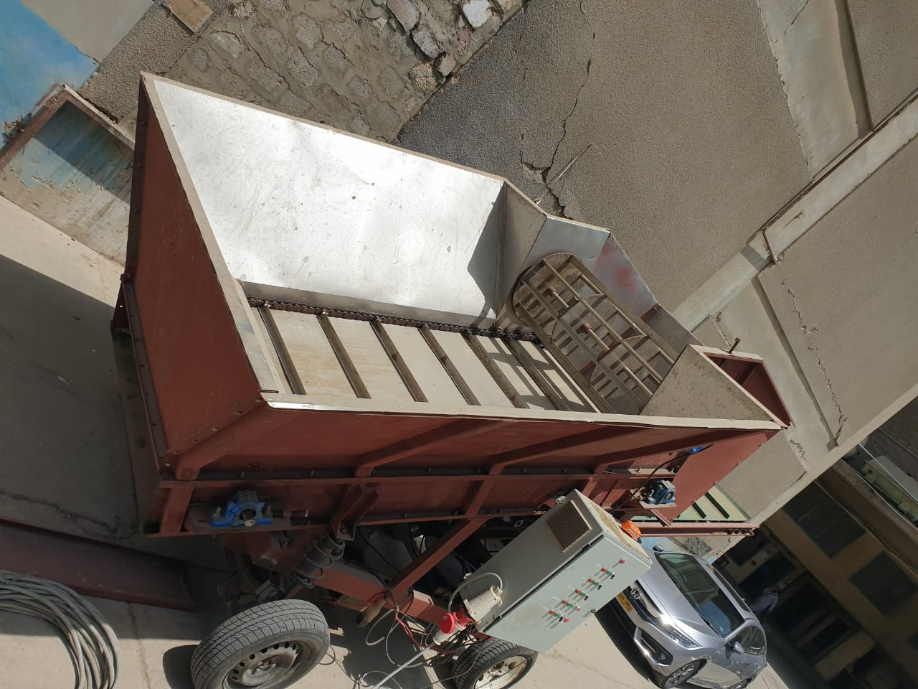
MUSHROOM PRODUCTION (BUNKER FILLING MACHINE)

Slide 15
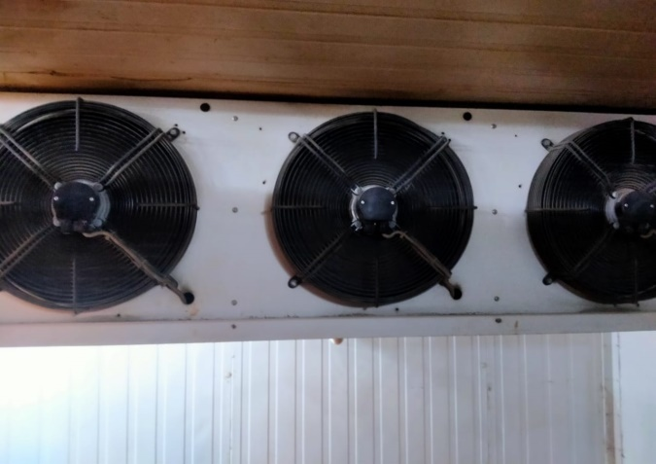
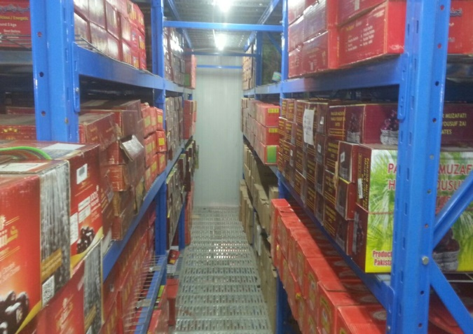
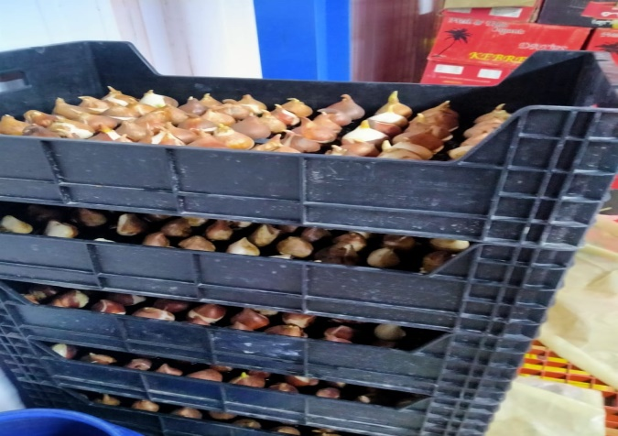
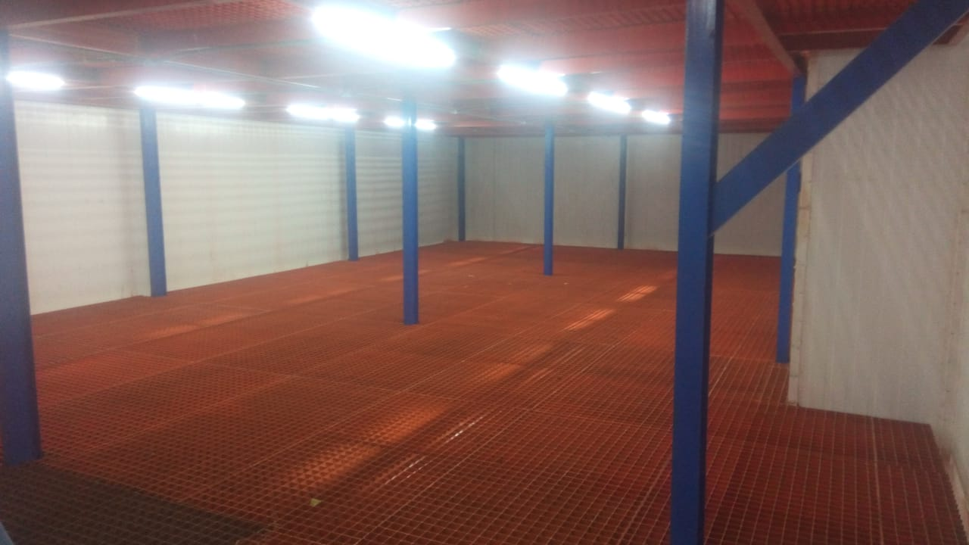
COLD STORE & WAREHOUSE

Slide 16
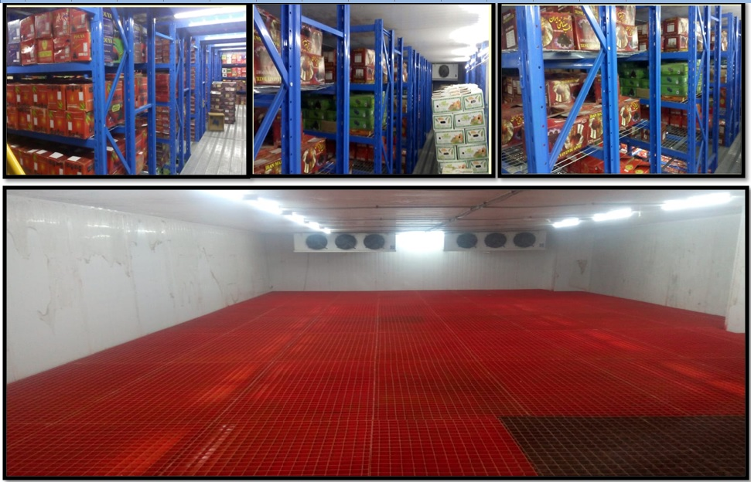

Slide 17
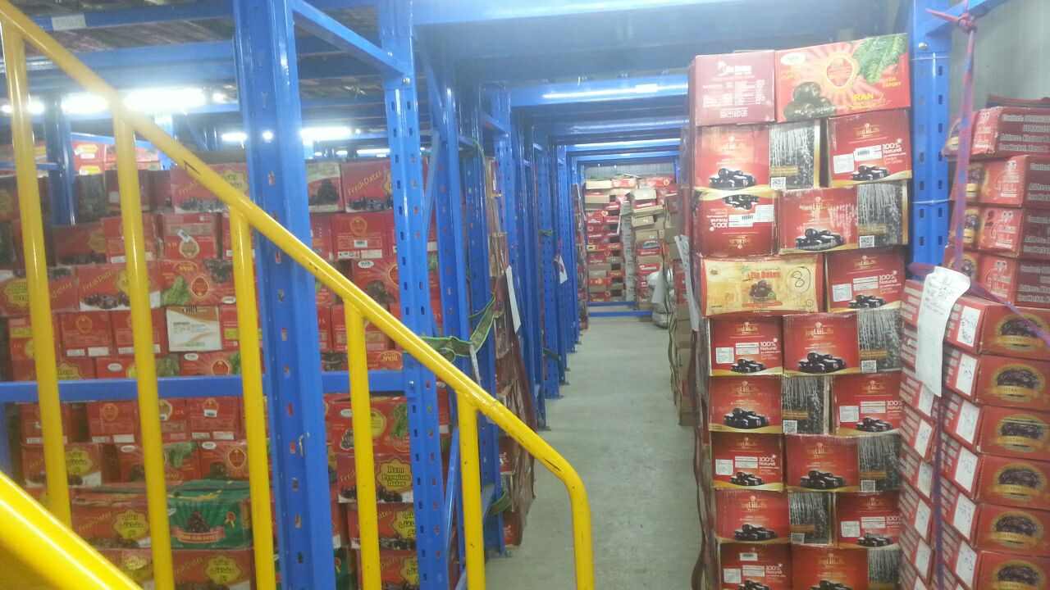
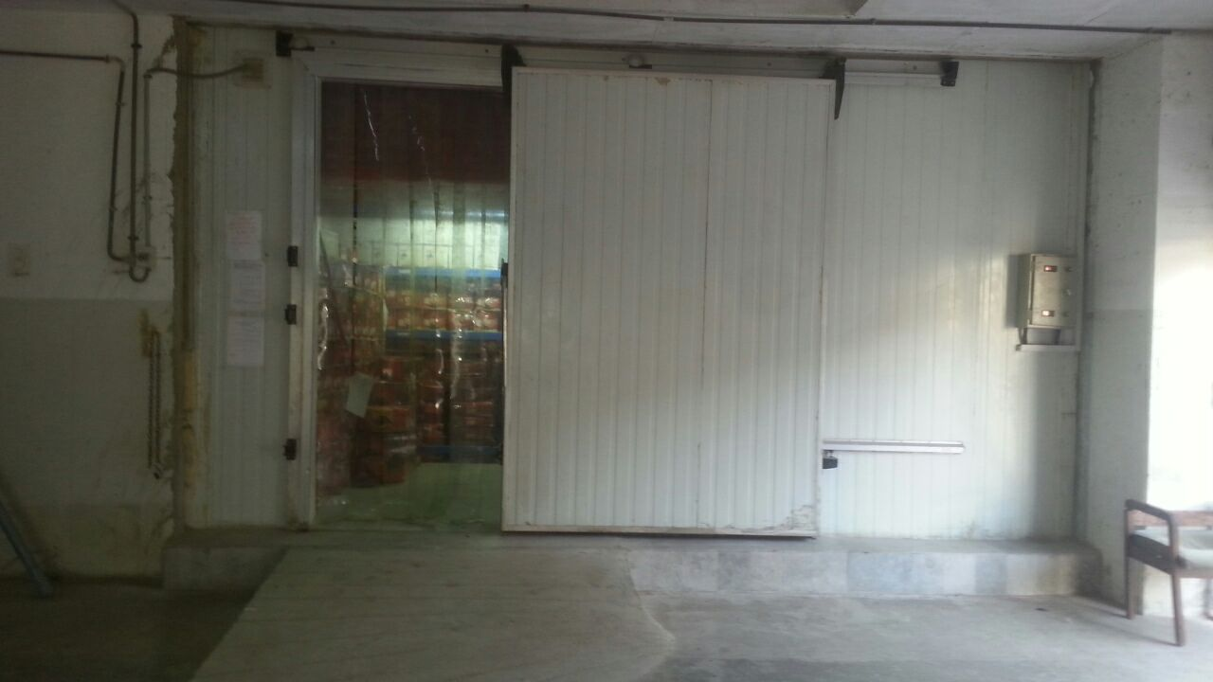
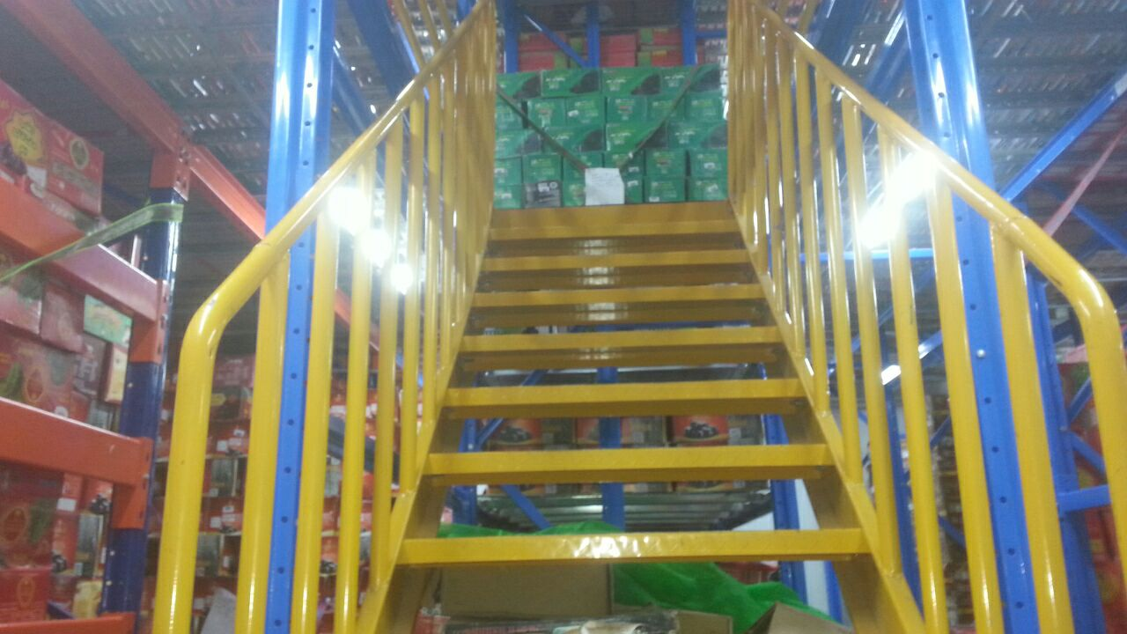
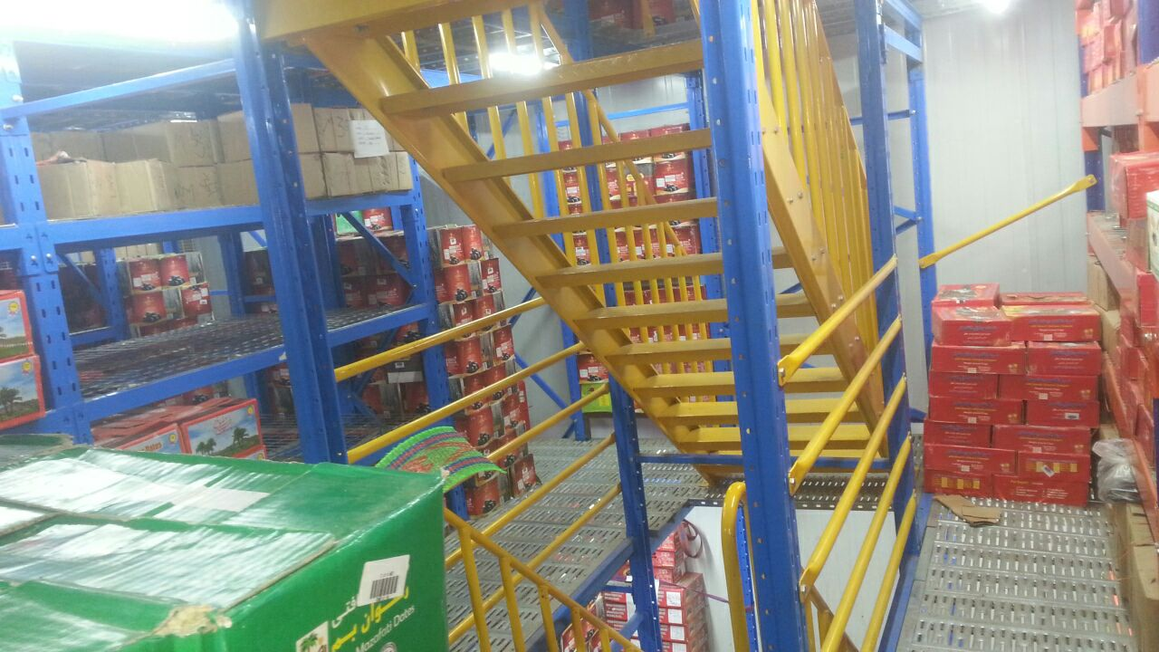

Slide 18
THANK YOU

